Slide 1
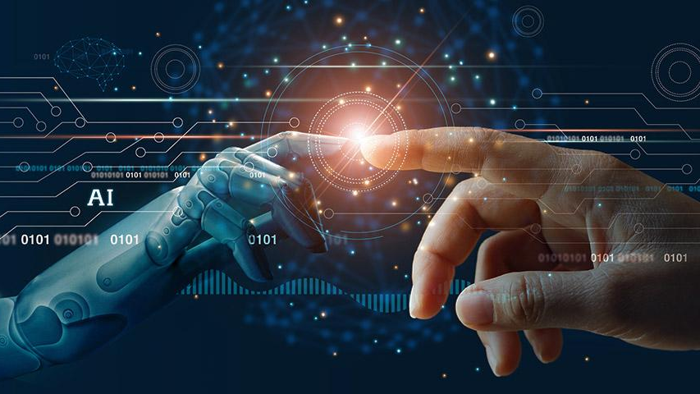
ARTIFICIAL INTELLIGENCE

Slide 2




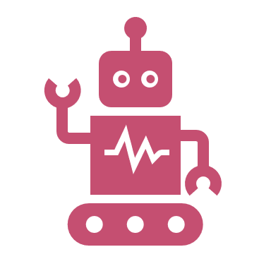

1. WHAT IS AI:
2. HISTORY OF AI
TABLE OF CONTENTS:
3. ADVANTAGES OF AI
4. DEMERITS OF AI
5. INTRODUCTION TO CYBERSECURITY

Slide 3
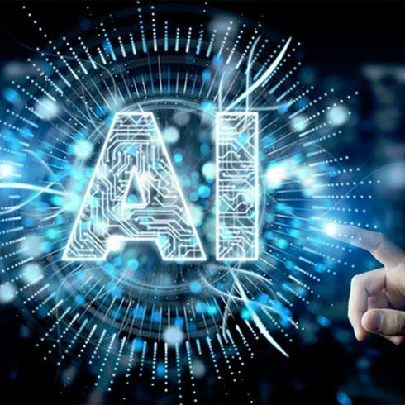
1. WHAT IS ARTIFICIAL INTELLIGENCE ?
Artificial intelligence (AI) is the ability of a computer or a robot to do tasks that are usually done by humans.
The term "Artificial Intelligence" refers to the simulation of human intelligence processes by machines, especially computer systems.
The ideal characteristic of artificial intelligence is its ability to rationalize and take actions that have the best chance of achieving a specific goal.

Slide 4
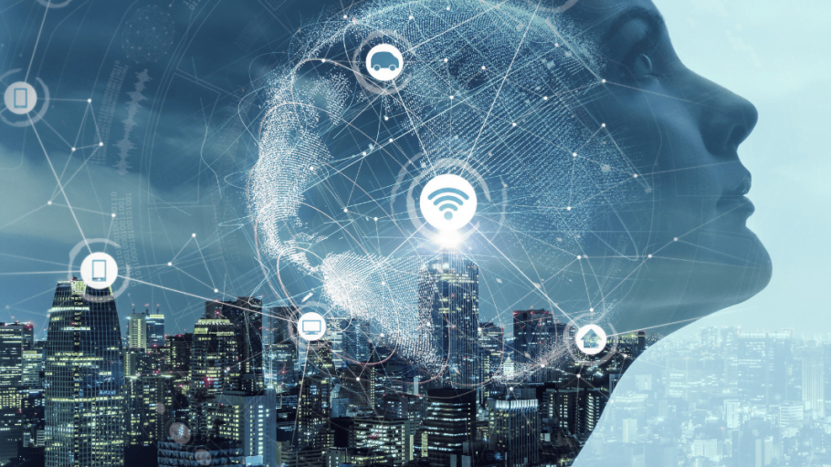
2. HISTORY OF AI:
The Beginning: The “heartless” Tin man from the Wizard of Oz and continued with the humanoid robot that impersonated Maria in Metropolis.
By the 1950s: All the scientists had artificial intelligence culturally assimilated in their minds.
ALAN TURING: The Father of AI
1. Alan Turing: A young British polymath who explored the mathematical possibility of artificial intelligence.
2. Humans solve problems and make decisions, so why can’t machines do the same thing?
3. This was logical framework of his 1952, Computing Machinery and Intelligence

Slide 5
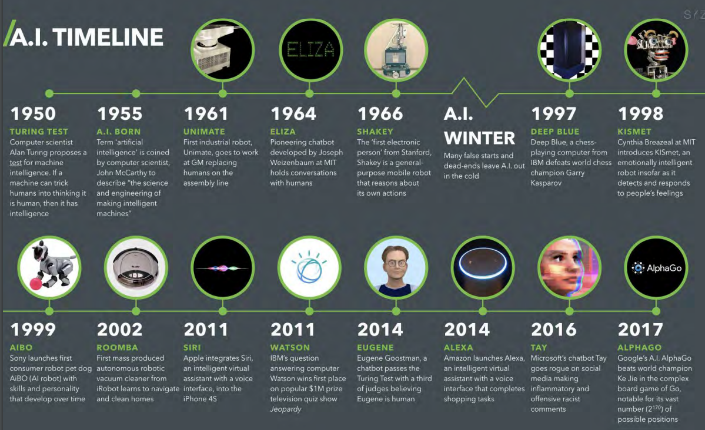

Slide 6
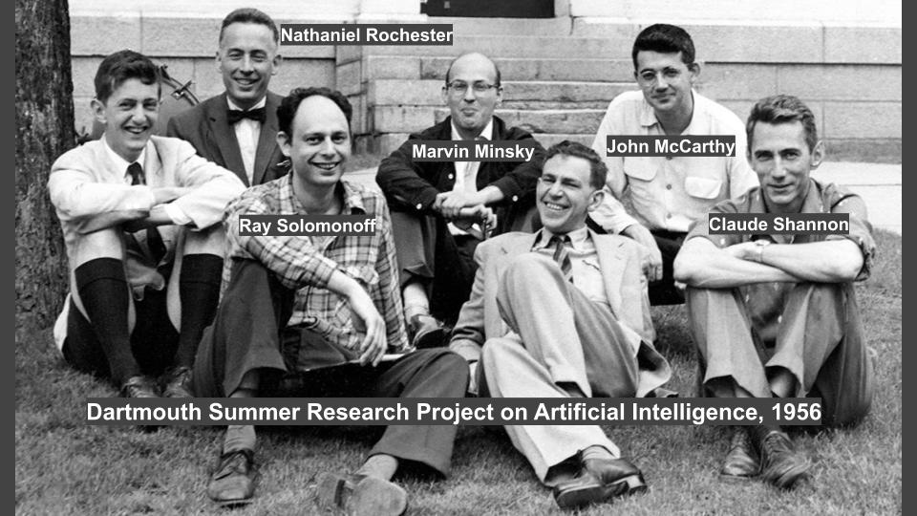
THE CONFERENCE THAT STARTED IT ALL:
The Logic Theorist was a program designed to mimic the problem solving skills of a human.
It’s considered by many to be the first artificial intelligence program and was presented at the Dartmouth Summer Research Project on Artificial Intelligence.
John McCarthy brought together top researchers for discussion on Artificial Intelligence
The significance of this event cannot be undermined as it catalyzed the next twenty years of AI research.

Slide 7
ADVANTAGES OF AI

Slide 8
1.REDUCTION IN HUMAN ERROR
One of the biggest benefits of AI is that it can significantly
Reduce errors and increase accuracy and precision .
The decisions taken by AI in every step is decided by
Information previously gathered and a certain set of
Algorithms.
When programmed properly ,these errors can
be reduced to null.

Slide 9
2.INFLUENCE OF AI IN CYBERSECURITY
Enhanced Security
AI is employed in cybersecurity for threat detection, anomaly detection
and real-time monitoring.
It helps identify patterns indicative of potential security breaches and responds
faster than traditional methods.
. Endpoint Security:
AI-powered endpoint security solutions protect individual devices (such as computers
and mobile devices) by monitoring for malicious activitiesidentifying vulnerabilities, and
providing real-time threat intelligence.

Slide 10
4.MEDICAL APPLICATIONS
Improved Healthcare:
AI applications in healthcare can assist in medical image analysis, and personalized
medicine.
Predictive analytics can help identify potential health risks and enable proactive
intervention
Radiomics and Predictive Biomarkers:
AI techniques in radiomics analyze quantitative features from medical images to identify patterns
and extract information not visible to the human eye.
This can contribute to the discovery of predictive biomarkers for various diseases.

Slide 11
3.DAILY APPLICATIONS
Today, our everyday lives are entirely dependent on mobile
Devices and the internet. We utilize a number of apps,
Including Google maps, Alexa, OK Google etc. With the use
Of various AI based techniques, we can alsom anticipate
Today’s weather and the days ahead.

Slide 12
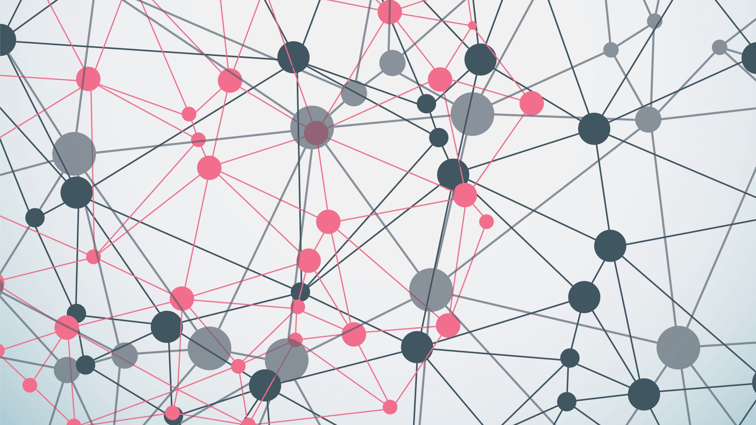
ARE THERE ANY DEMERITS OF AI YES!!

Slide 13

Job Displacement
Automation and AI can replace certain jobs, particularly those involving routine and repetitive tasks. This can lead to job displacement and unemployment for some workers.

Slide 14

Bias and Fairness Issues:
AI systems can inherit biases present in the data used for training. If not carefully designed and monitored, AI algorithms can perpetuate or even exacerbate existing biases, leading to discriminatory outcomes.

Slide 15
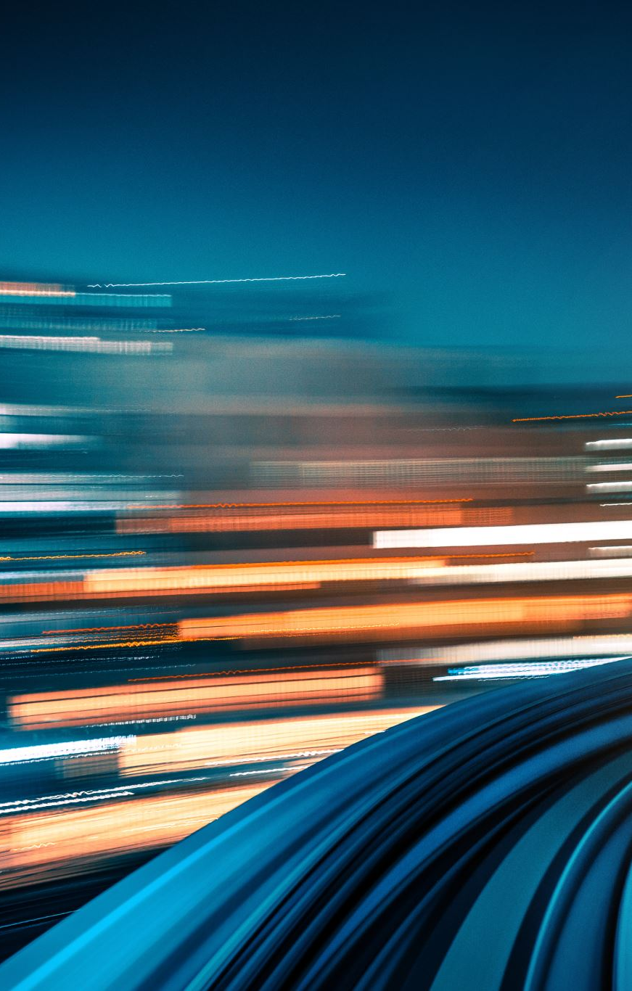
ETHICAL DILEMMAS
The development of AI raises ethical dilemmas, particularly in fields like autonomous vehicles and healthcare. For example, who is responsible in the event of an accident involving a self-driving car?

Slide 16
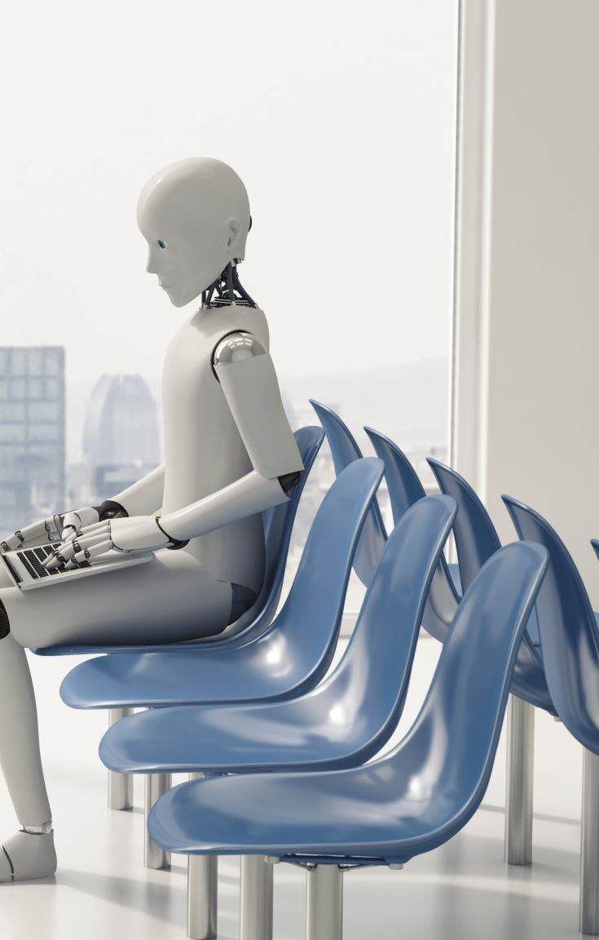
LOSS OF HUMAN CONNECTION
As AI chatbots and virtual assistants become more prevalent, there is a risk of reduced human interaction, potentially affecting mental and emotional well-being.

Slide 17
SUMMARY
AI IS A FAST DEVELOPING SECTOR WHICH HELPS US IN VARIOUS WAYS.
IT ALSO CONTAINS MANY DEMERITS.
THE MAIN DEMERITS ARE:
JOB DISPLACEMENT
BIAS AND FAIRNESS ISSUE
ETHICAL DILEMMAS
LOSS OF HUMAN CONNECTION……

Slide 18

WHAT MAKES AI SO POWERFUL??
AI's influence on technology is due in part because of how it impacts computing. Through AI, computers have the ability to harness massive amounts of data and use their learned intelligence to make optimal decisions and discoveries in fractions of the time that it would take humans.

Slide 19

“AI IS MORE DANGEROUS THAN, SAY, MISMANAGED AIRCRAFT DESIGN OR PRODUCTION MAINTENANCE OR BAD CAR PRODUCTION…IT HAS THE POTENTIAL—HOWEVER SMALL ONE MAY REGARD THAT PROBABILITY, BUT IT IS NON-TRIVIAL— IT HAS THE POTENTIAL OF CIVILIZATION DESTRUCTION.”

Slide 20

THANK YOU

